Slide 1
Mathematical basis for examining tetraploidy as an intermediate state in CIN
Compton Lab Presentation 11/5/2015

Slide 2

The Team!
Kelly Brock
Marianna Kleyman
Andrew Chen
Douglas White
Arijit Chakravarty

Slide 3
CIN is an evolutionary process
Tumor cells displaying CIN (chromosome instability) develop aneuploidy over time
Different karyotypes have cell-specific relative fitnesses
  Tetraploidy has been demonstrated to be an intermediate state in CIN development
Difficult to track in vivo -> need for modeling

Slide 4
CIN-derived aneuploidy state can proceed through tetraploidy
Storchova and Kuffer 2008
  http://jcs.biologists.org/content/121/23/3859.full
  Tetraploidy associated with increased CIN levels (http://www.ncbi.nlm.nih.gov/pubmed/18813350)
  Tetraploidy can be a precursor to increased CIN
  Presented today: Our results consistent with tetraploidy “pushing” cells into flatter fitness landscape
Beyond distinguishing CIN from non-CIN, fitness landscapes can help us understand how CIN arises and becomes more drug-resistant

Slide 5
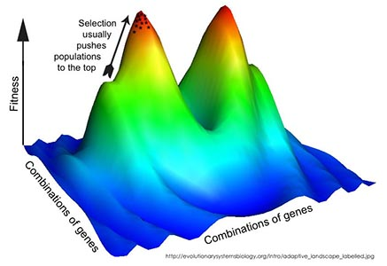
Ploidy can contribute selective (dis)advantage
Fitness landscape: mapping characteristics (e.g. karyotype data) to likelihood of reproduction
Will approximate discrete chromosome counts as continuous equation
http://evolutionarysystemsbiology.org/intro/adaptive_landscape_labeled.jpg

Slide 6

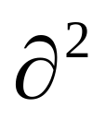
Recap: Modeling CIN as a diffusion-growth process
How population changes with time (generations)
Chromosome number after missegregation
Cell growth proportional to fitness
p(x,t)
p(x,t)
=
μ
+
F(x)
p(x,t)
t
x²
p(x,t): Population distribution at x = number of chromosomes and t = time
μ: chromosome missegregation rate
F(x): fitness of a cell with x number of chromosomes
Notes:
Make animated, color coded, arrows – show parts of the equation one at a time and explain what second derivative is

Slide 7
Deriving fitness landscapes under steady-state assumption
Given the missegregation rate and steady-state population distribution, we can predict the underlying fitness landscape
p(x,t): Population distribution at x = number of chromosomes and t = time
p(x,t)
-
μ
x²
F(x): fitness of a cell with x number of chromosomes
=
F(x)
μ: chromosome missegregation rate
p(x,t)

Slide 8
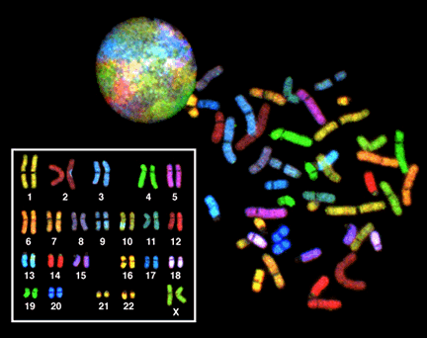
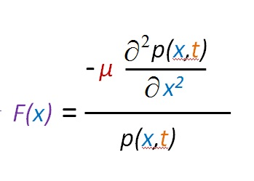
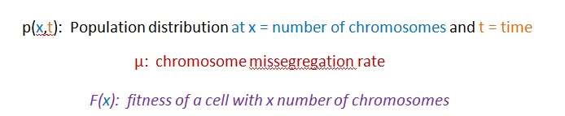
Can we understand how tetraploidy is connected to CIN using Kristina’s data?
https://en.wikipedia.org/wiki/Karyotype
Our SKY data comes from GliNS2 cells, derived from a 54-year-old patient with glioblastoma multiforme

Slide 9
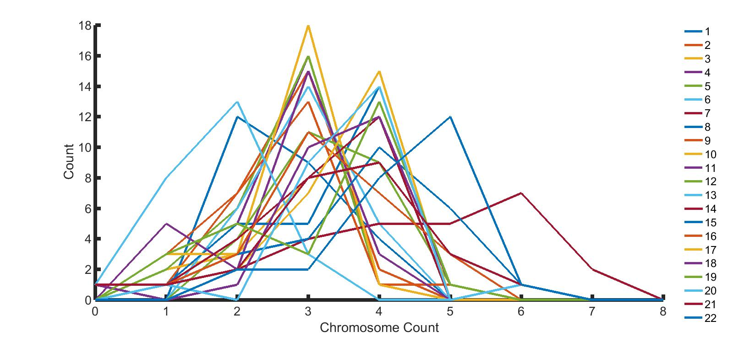
SKY data for 25 cells – chromosome-specific distributions

Slide 10
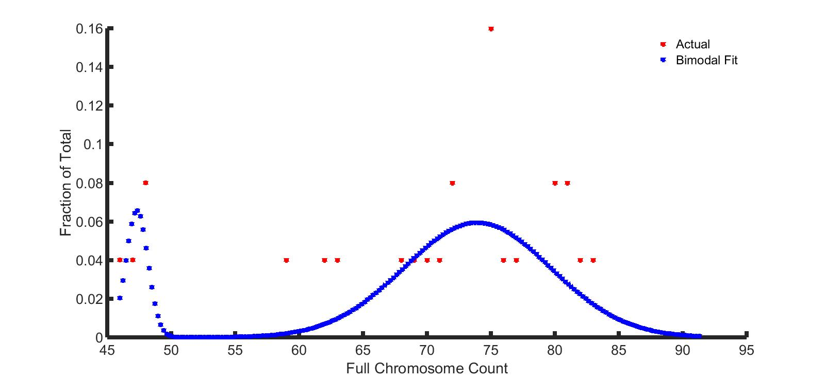
SKY data exhibits bimodality

Slide 11
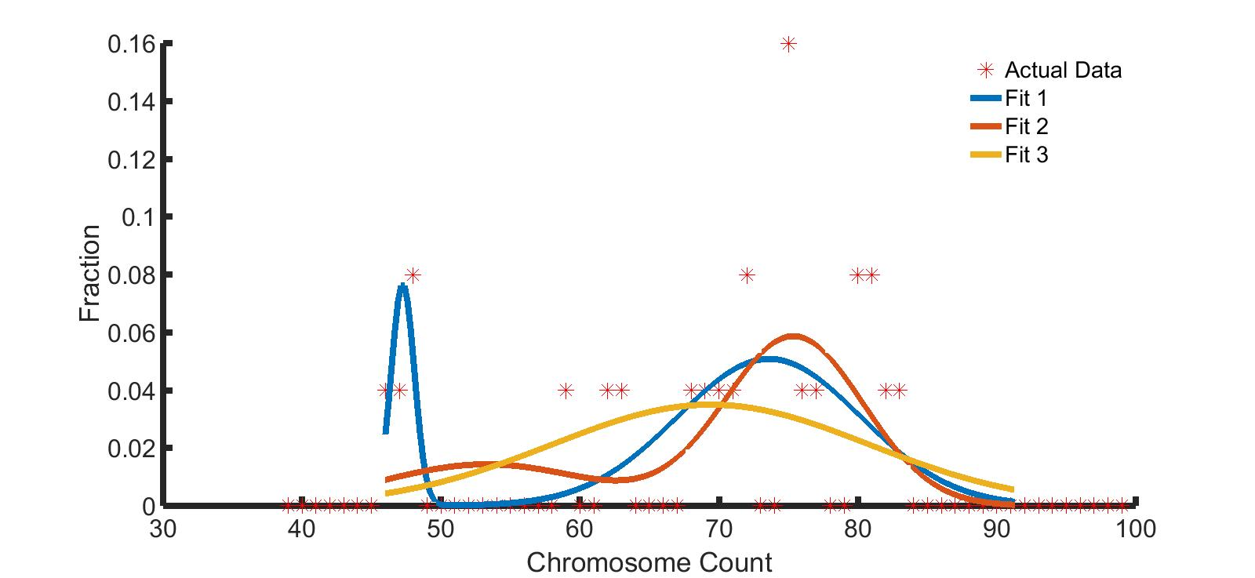
How good is our fit?
99% give Fit 1 (least error) for 456 trials
  Other fits have difficulty w/ bimodality

Slide 12
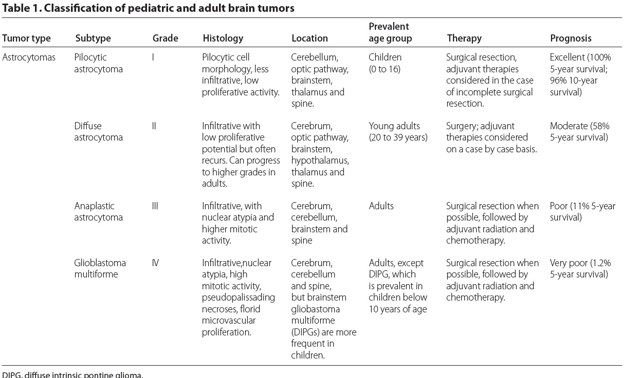
Connecting to clinical data – do astrocytomas show bimodal behavior?
Gerges et al. Genome Medicine 2013, 5:66

Slide 13
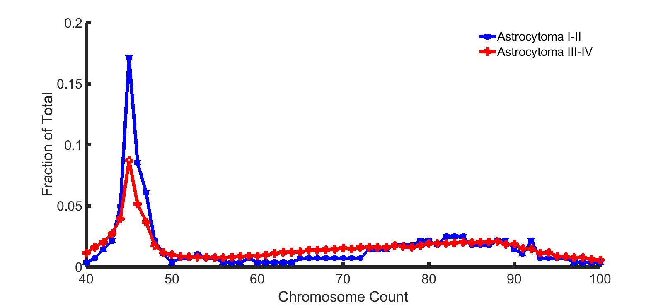
Astrocytomas have bimodal distributions influenced by prognosis

Slide 14
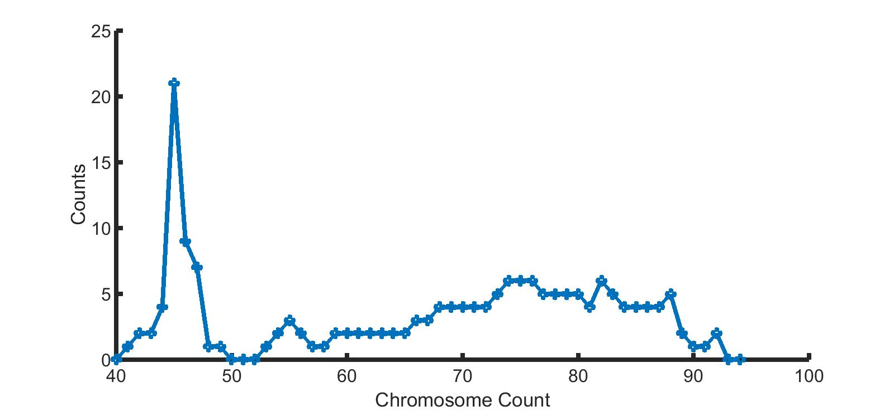
Glioblastoma NOS also bimodal

Slide 15
Extracting fitness landscapes from full chromosome distributions
Previous FISH data: Chr10
Now we have whole chromosome counts – how does this affect fitness for glioblastoma cells?
  Can we understand how underlying fitness contributes to CIN’s “debut”?
  Use previous model

Slide 16
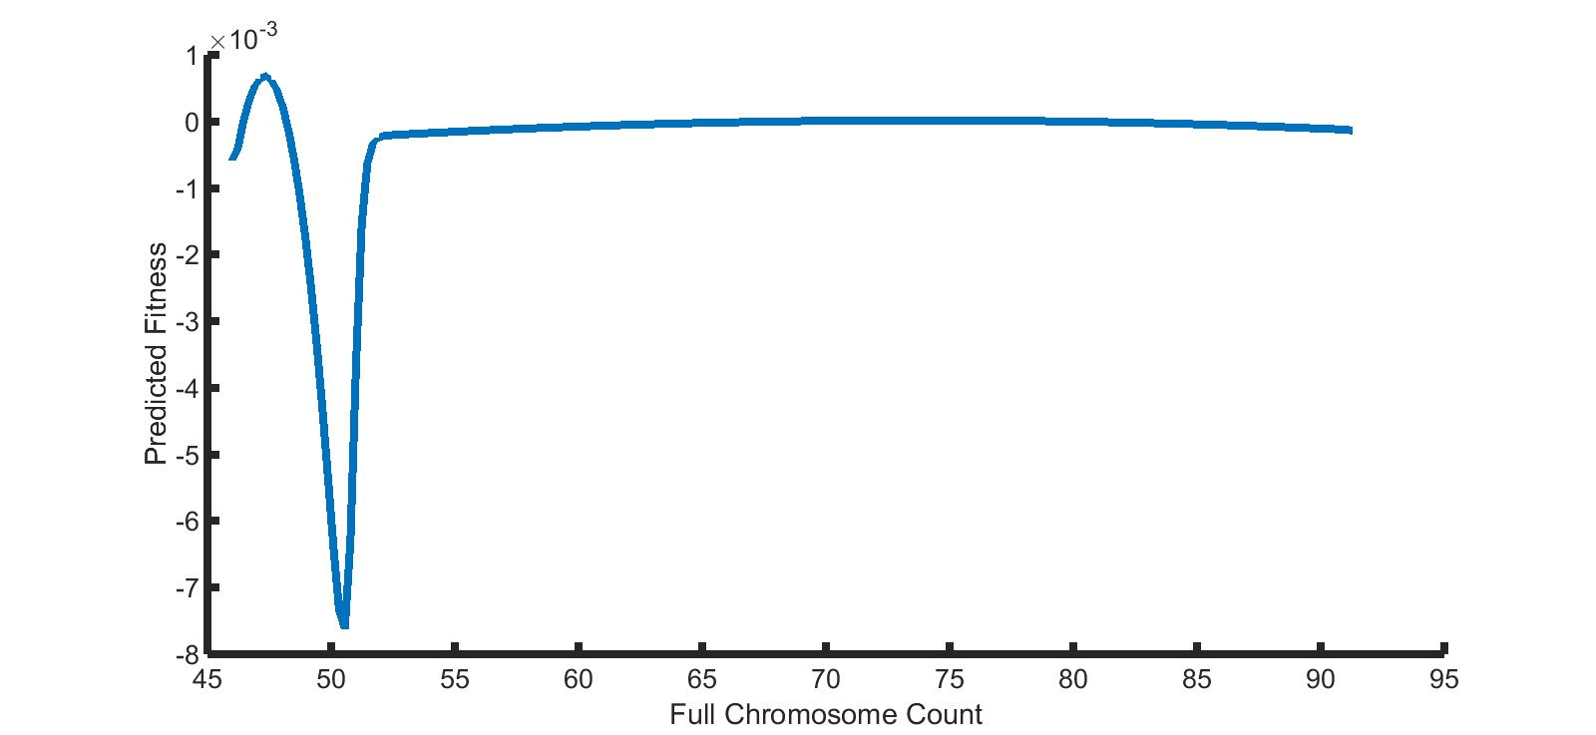
Predicted fitness landscape – potential explanation for tetraploidy initiation?
Notes:
If you’re tetraploid first, you have way more genetic/karyotypic things to discover, as opposed to needing to adapt immediately and make the jump
Neg – pop growth

Slide 17
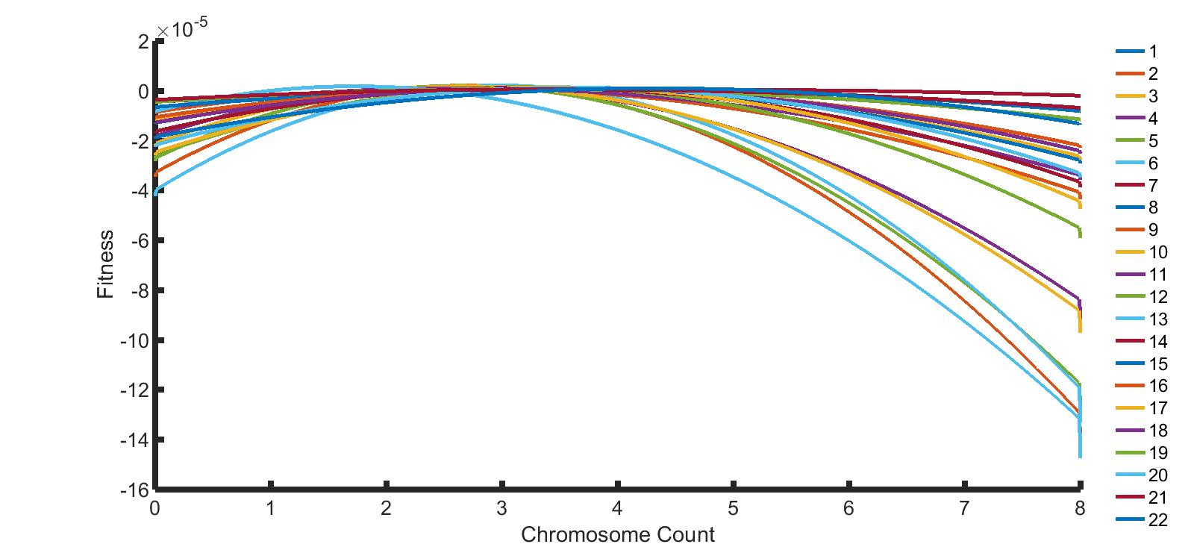
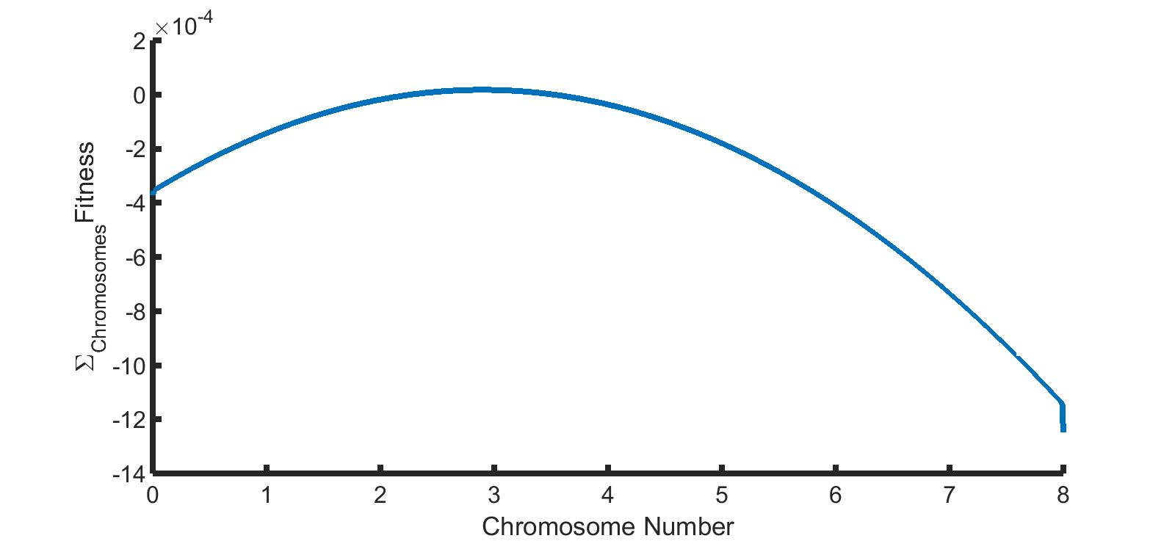
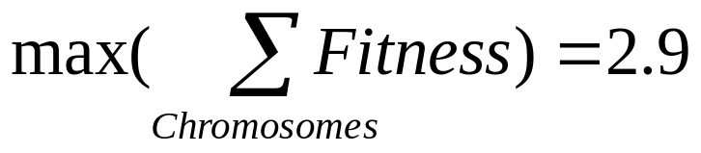
Fitness landscapes for individual chromosomes

Slide 18
Appendix

Slide 19
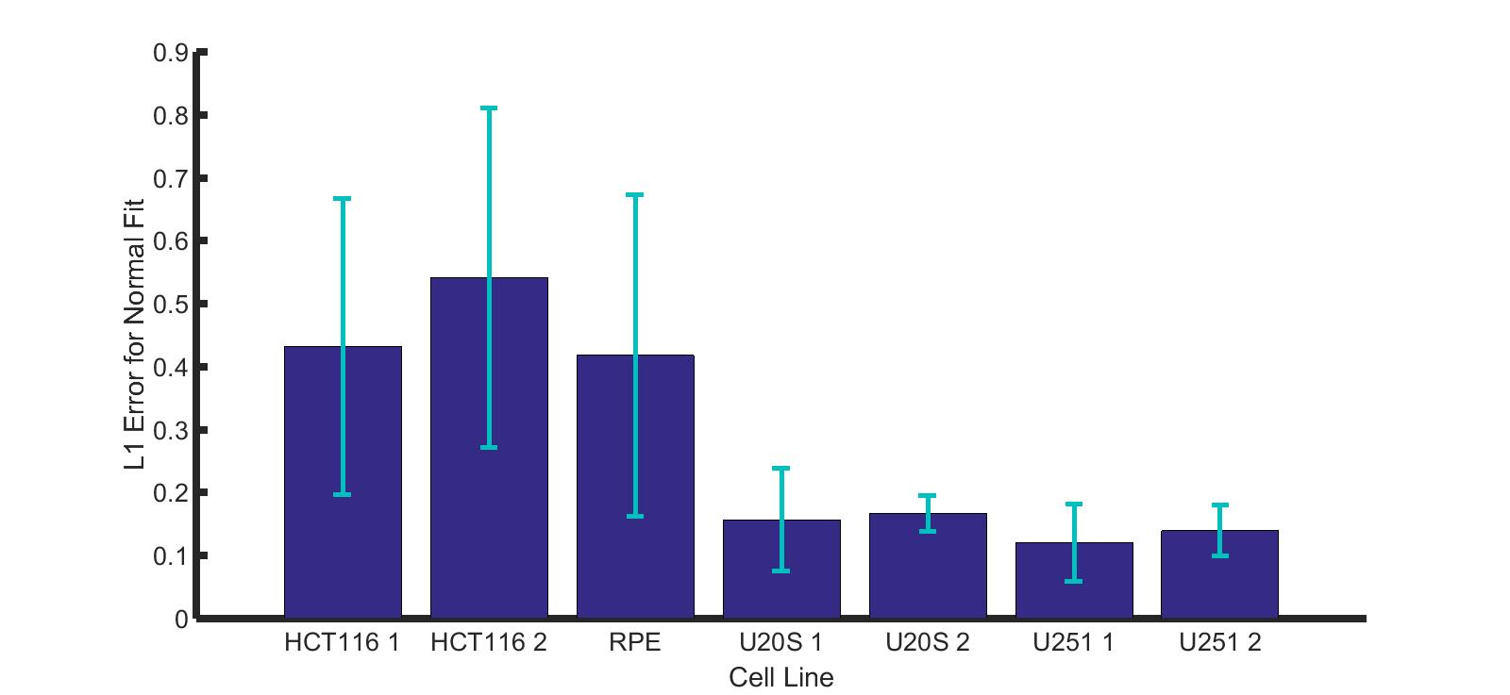


CIN lines better fit by normal distribution than non-CIN lines
Non-CIN
CIN

Slide 20
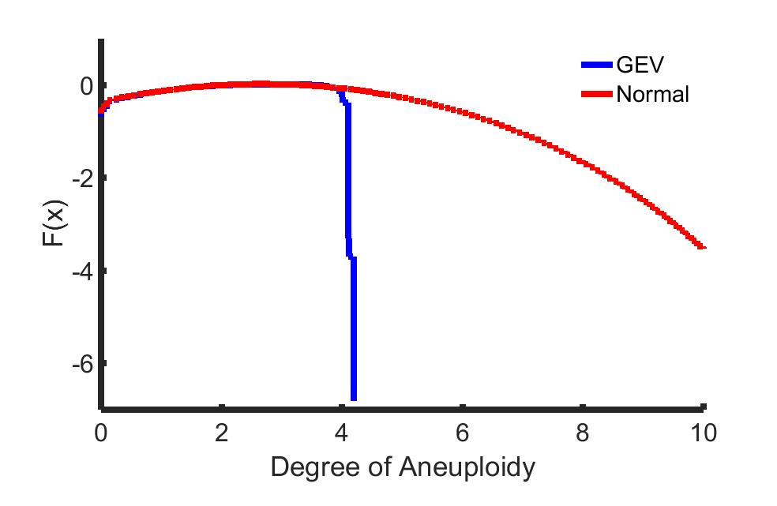

Normally fit distributions have flatter fitness landscapes
Fitness
Number of Chromosomes

